Slide 1
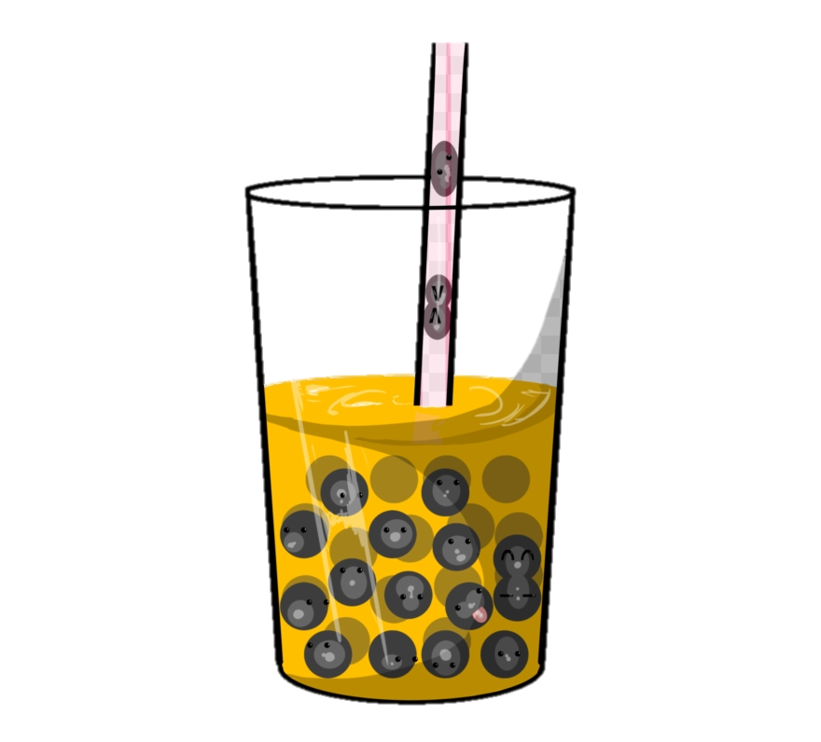

TEEFFEE
Ganzolboo Ayurzana
Minho CHA

Slide 2
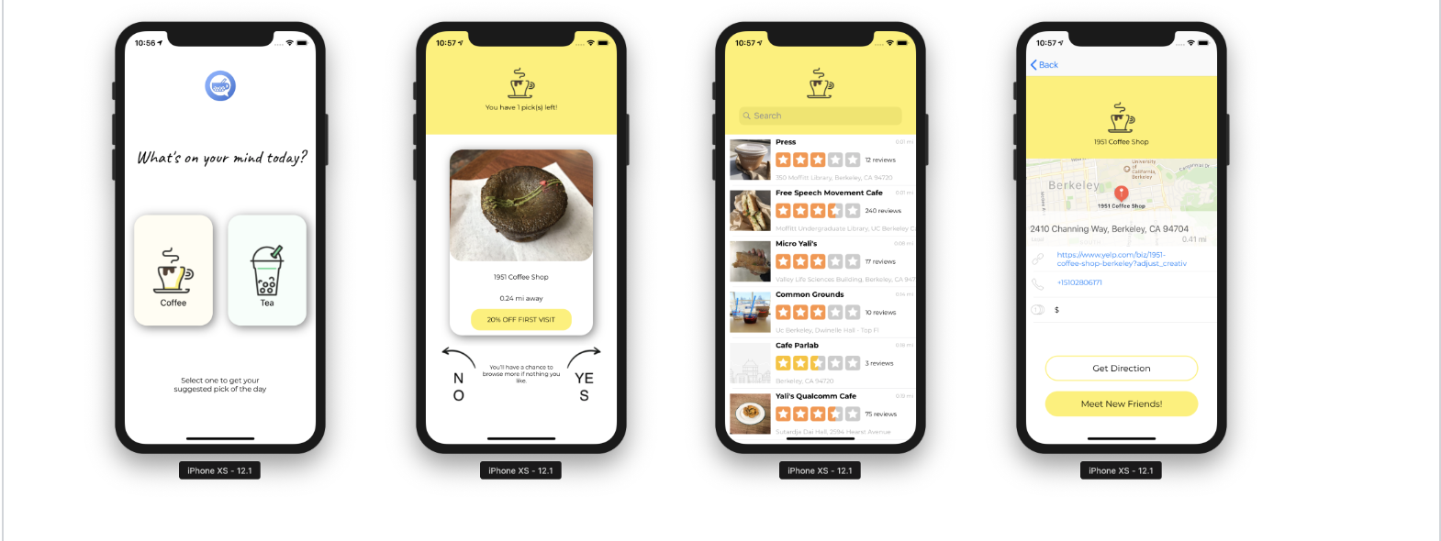
Overwiew
A location based app helps people explore nearby boba/ coffee shop with 3 picks of the day. Enjoy the drink, discover and chat with friends.

Slide 3
Technology
Yelp Fusion API
Google map API
Chatto (Open Source framework)
MultipeerConnectivity (IOS SDK)

Slide 4
Features
Generates random boba or coffee shop recomendation based on users' current location
View custom coupon
Browse complete list of nearby shops
Provides basic information of shops (URL, price range, phone number)
Supports peer-to-peer connectivity and the discovery of nearby devices
Message count contention for fast pagination and rotation (not yet implemented)
Text bubbles (not yet implemented)

